Slide 1
Bodh Ventures
AussieVisaDocs
Clearer visa document preparation for multilingual users.
A Bodh Ventures product brief
contactus@bodhventures.com

Slide 2
AussieVisaDocs
Making visa documentation preparation clearer and more accessible.
Mission
AussieVisaDocs is a practical document drafting and workflow preparation assistant for Australian visa-related documentation. It is designed to help users organise information, express their own facts more clearly, and prepare review-ready document packs.
Approach
The product uses structured workflows rather than open-ended chat. Users select a document workflow, add their own details, and receive drafting, translation, rewriting, checklist, and evidence-organisation support.
Approach
AussieVisaDocs is not a migration-advice product. It keeps final decisions, official requirements, and professional advice with Australian Government sources, registered migration agents, and legal practitioners.
Bodh Ventures | contactus@bodhventures.com
2

Slide 3
AussieVisaDocs
Visa documentation can be complex, stressful, and language-heavy.
Fragmented requirements
Language and drafting barriers
Unclear evidence organisation
Applicants often manage forms, identity documents, financial records, translations, statements, and evidence across many files and instructions.
Multilingual users may know their facts clearly but struggle to present them in professional English or consistent document structure.
Users need a simple way to map statements, supporting files, source notes, and review tasks without confusing document drafting with migration advice.
Bodh Ventures | contactus@bodhventures.com
3

Slide 4
AussieVisaDocs
Built for users who need clearer document preparation.
Audience 1
Audience 2
Individual applicants and families preparing supporting documents
Multilingual users who need drafting and translation support
Audience 3
Audience 4
Students, skilled workers, visitors, and family-related applicants
Future professional workflow mode for registered migration agents or legal practitioners
Bodh Ventures | contactus@bodhventures.com
4

Slide 5
AussieVisaDocs
What sets AussieVisaDocs apart.
Multilingual drafting support
Structured document preparation workflows
Evidence checklist organisation
Designed as a focused capability within the document preparation workflow.
Designed as a focused capability within the document preparation workflow.
Designed as a focused capability within the document preparation workflow.
Source-aware preparation using official/public information
Human review and professional escalation pathway
Compliance-first positioning
Designed as a focused capability within the document preparation workflow.
Designed as a focused capability within the document preparation workflow.
Designed as a focused capability within the document preparation workflow.
Bodh Ventures | contactus@bodhventures.com
5

Slide 6
AussieVisaDocs
From scattered documents to a structured preparation pack.
1
2
3
4
5
Select workflow or document type
Add user-provided details and supporting files
Draft, translate, or rewrite content
Organise documents against a preparation checklist
Export a review-ready document pack
Drafting support only. Not migration or legal advice.
Bodh Ventures | contactus@bodhventures.com
6

Slide 7
AussieVisaDocs
Drafting support, not migration advice.
No visa outcome guarantees
No legal or migration advice
No replacement for official sources or qualified professionals
Encourages professional review where advice is required
Uses guardrails, disclaimers, audit trail, and source references
Compliance-first copy
Use document drafting and workflow support, preparation support, and professional review pathways. Do not claim advice, eligibility assessment, recommendations, or outcome guarantees.
Bodh Ventures | contactus@bodhventures.com
7

Slide 8
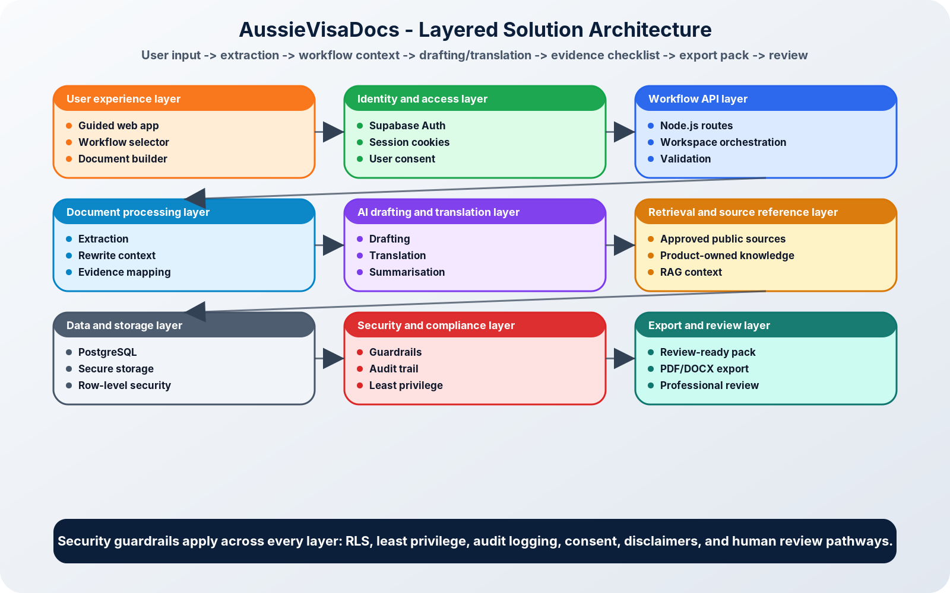
AussieVisaDocs
High-Level Architecture
Bodh Ventures | contactus@bodhventures.com
8

Slide 9
AussieVisaDocs
Concept / beta build direction
Current status: Concept and product design in progress.
Planned
In design
Product page assets, architecture brief, public-safe copy, and workflow requirements.
Structured drafting flows, multilingual answer support, evidence checklist concepts, and product guardrails.
Future beta
Future professional review workflow
Private beta with selected users after core document workflow, persistence, review, and export features are stable.
Optional pathway for registered migration agents or legal practitioners to review document packs where advice is required.
Bodh Ventures | contactus@bodhventures.com
9

Slide 10
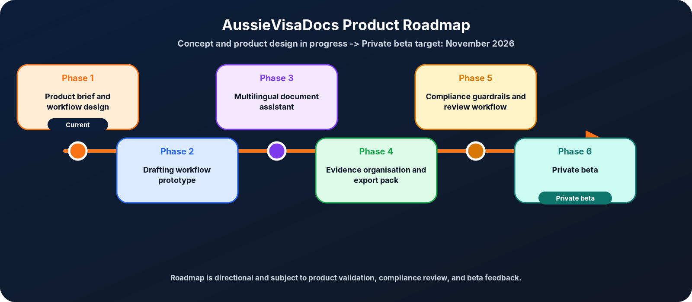
AussieVisaDocs
Roadmap
Project-manager-style timeline from brief to private beta.
Bodh Ventures | contactus@bodhventures.com
10

Slide 11
Bodh Ventures
Bodh Ventures builds practical AI products for real-world problem areas.
Domains
Domains
Base
Migration workflows
Spirituality
Wellbeing
Education
Knowledge systems
Practical AI tooling
Sydney, Australia
contactus@bodhventures.com
Bodh Ventures | contactus@bodhventures.com
11

Slide 12
AussieVisaDocs
Clearer document preparation for Australian visa workflows.
Connect with Bodh Ventures
contactus@bodhventures.com
Required disclaimer
AussieVisaDocs is intended to support document drafting, translation, organisation, and workflow preparation. It does not provide migration advice, legal advice, or visa outcome guarantees. Users should consult official Australian Government sources or a registered migration agent/legal practitioner where immigration advice is required.
Bodh Ventures | contactus@bodhventures.com
12

